Slide 1
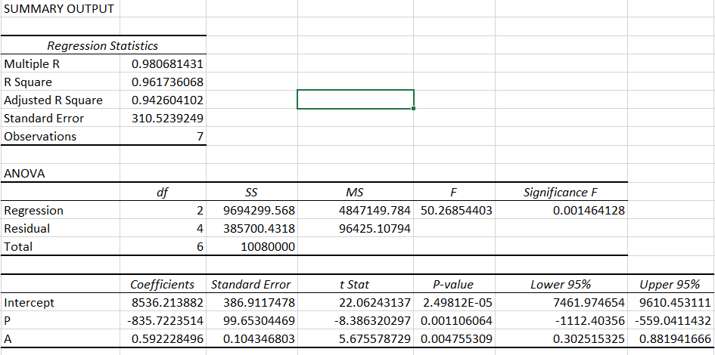
Excel (cantidades vendidas, precio, publicidad)

Slide 2
PYTHON

Slide 3
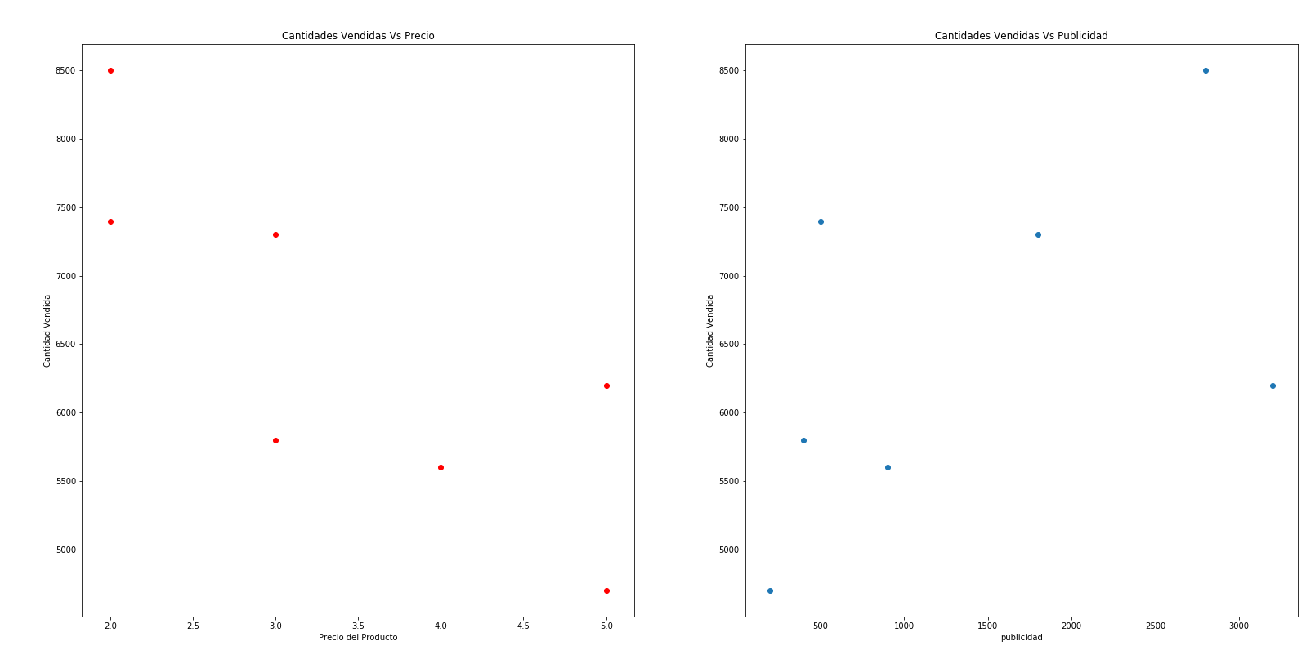

Slide 4
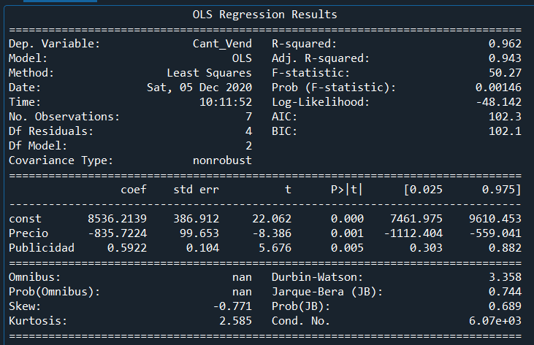

Slide 5
Python vs Excel

Slide 6
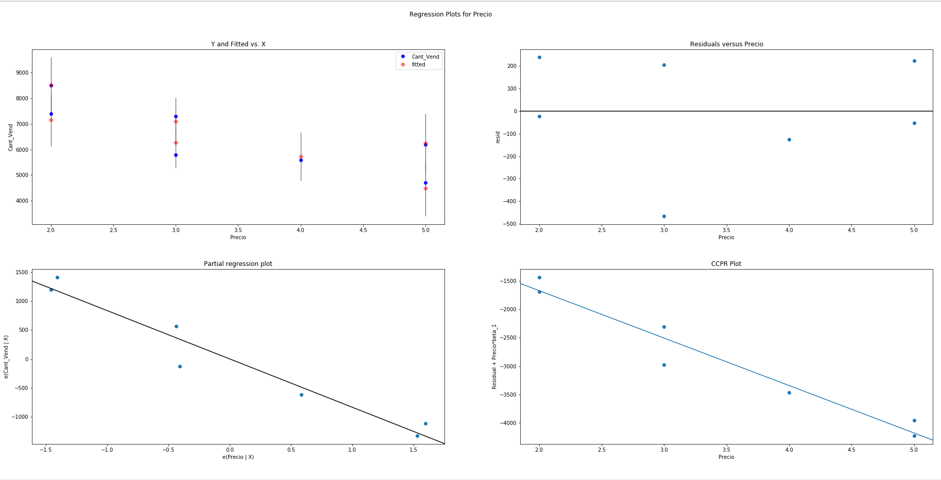
Residuals plots for Quantity Sold vs Precio

Slide 7
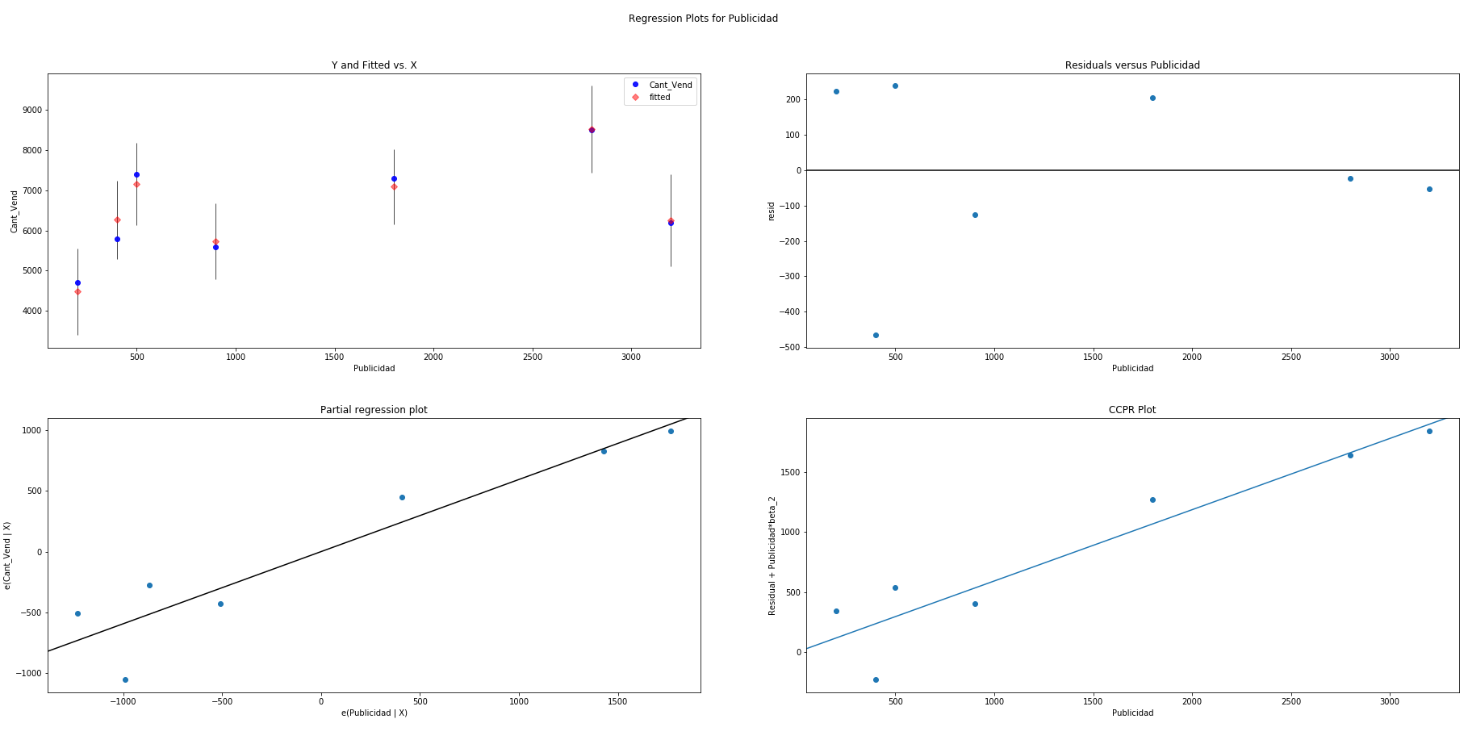
Residuals plots for Quantity Sold vs Publicidad

